Slide 1
Advanced Data Analysis More linear models 367-2-5461
This was too short by about an hour. So was the last lecture!
Opher Donchin

Slide 2
Things we know how to do that are hard for frequentists
Using prior information
For accurate predictions
For regularization
Robust estimation
Credible intervals
Change point analysis
Self-correcting workflow
Hierarchical modeling
Regression models
Intuitive
Flexible
Model comparison
Generally applicable
Self correcting

Slide 3
Topics
Homework
Regression packages
Wilkinson notation
Regression packages
Bambi
Conditional prediction
Splines
Additional Bambi specifications
Distributional models
Hierarchical Bambi
Interactions in Bambi

Slide 4
Homework
What dinosaur models did you look at?

Slide 5
Wilkinson notation
Why do we need it?
What is it?
Where is it used?
What does it look like?

Slide 6
Wilkinson notation: why do we need it?
Statistical computing
The need to specify regression models
Each package with a different syntax
Increased complexity and confusion
Early statistical computing
Wilkinson and Rogers
Incorporated into R
nlme
1960s
1973
1993
1999

Slide 7
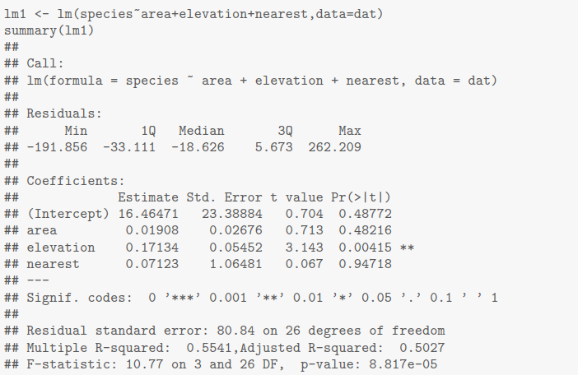


Wilkinson notation: what is it?
Emerged from the GLIM program
Provides a unified grammar for expressing statistical models
Adopted initially by R and then spread widely
GLIM

Slide 8
Wilkinson notation: where is it used?
R
lme4: mixed effect models
brms: Bayesian regression (based on Stan)
mgcv: generalized additive models
Matlab
fitlm: Linear regression modeling
fitlm: Generalized linear models
fitnlm: Non-linear regression
Python
statsmodels: Classical modeling
Bambi: Bayesian modeling
formulaic: formula processing
patsy: more formula processing
Julia
GLM.jl: Generalized linear models
MixedModels.jl: Mixed effects models
StatsModels.jl: Formula interface

Slide 9
Topics
Homework
Regression packages
Wilkinson notation
Regression packages
Bambi
Conditional prediction
Splines
Additional Bambi specifications
Distributional models
Hierarchical Bambi
Interactions in Bambi

Slide 10

Bambi
Formula based interface to PyMC
Graphics based on arviz
Automatic priors
Feature rich
a_model = bmb.Model("y ~ x", data)
no_intercept_model = bmb.Model("y ~ 0 + x", data)
model_2 = bmb.Model("y ~ x + z", data)
model_h = bmb.Model("y ~ x + z + (x | g)", data)
model = bmb.Model("drugs ~ o + c + e + a + n", data)
fitted = model.fit(tune=2000, draws=2000, init="adapt_diag", random_seed=SEED)

Slide 11
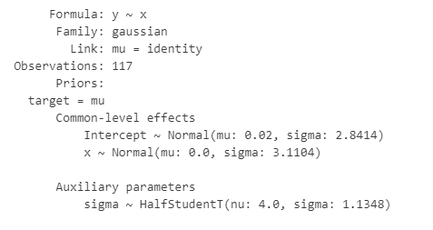
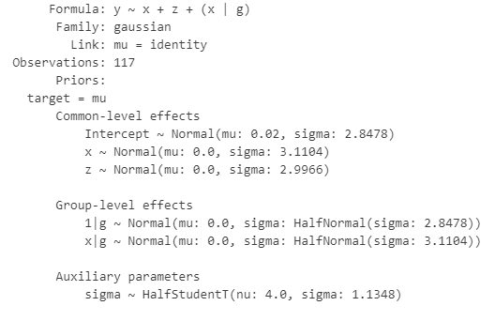
What’s in bambi models
a_model = bmb.Model("y ~ x", data)
a_model
model_h = bmb.Model("y ~ x + z + (x | g)", data)
model_h

Slide 12
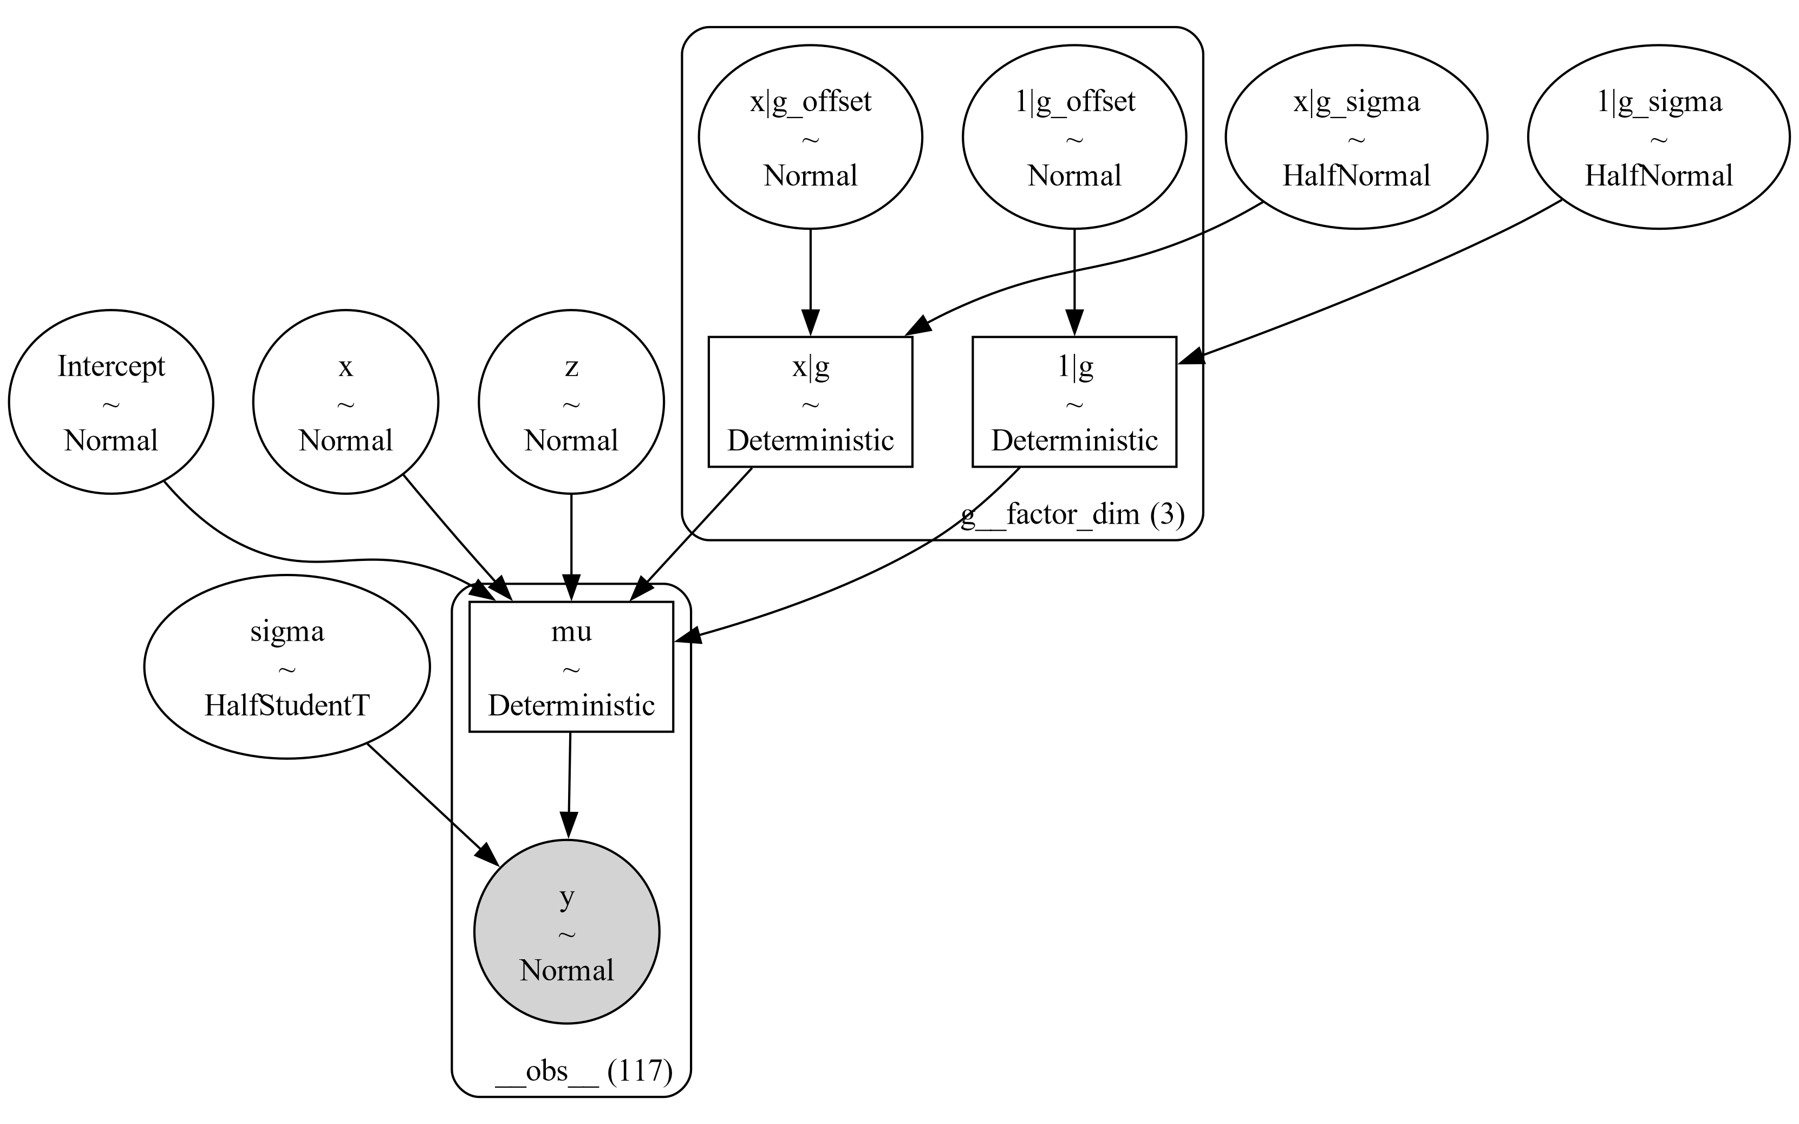
model_h = bmb.Model("y ~ x + z + (x | g)", data)
model_h.build()
model_h.graph(name="../fig/bambi_dag")

Slide 13
model_h = bmb.Model("y ~ x + z + (x | g)", data)

Slide 14
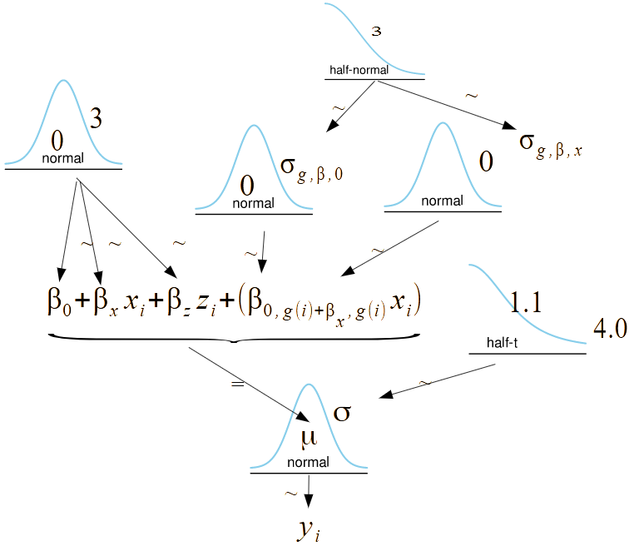
model_h = bmb.Model("y ~ x + z + (x | g)", data)

Slide 15
Topics
Homework
Regression packages
Wilkinson notation
Regression packages
Bambi
Conditional prediction
Splines
Additional Bambi specifications
Distributional models
Hierarchical Bambi
Interactions in Bambi

Slide 16
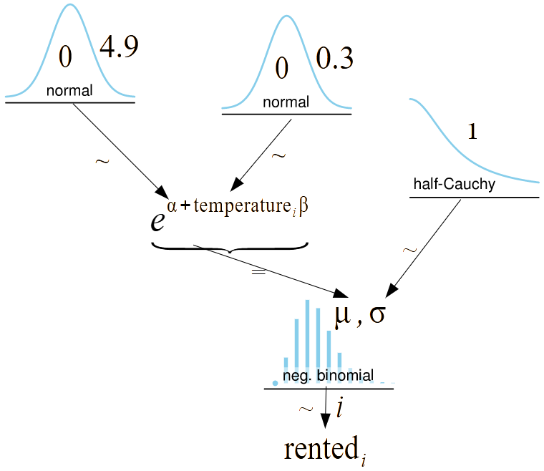
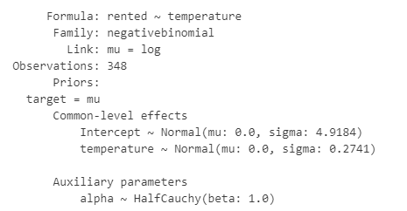
The bikes model
model_t = bmb.Model("rented ~ temperature", bikes, family="negativebinomial")
idata_t = model_t.fit(random_seed=123)

Slide 17
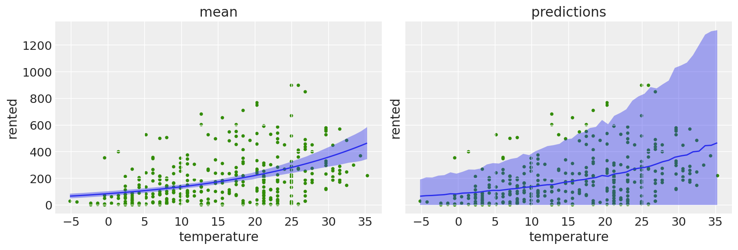
Posterior and posterior predictive
bmb.interpret.plot_predictions(model_t, idata_t, "temperature", ax=axes[0])
bmb.interpret.plot_predictions(model_t, idata_t, "temperature", pps=True, ax=axes[1])
axes[0].plot(bikes.temperature, bikes.rented, "C2.", zorder=-3)
axes[1].plot(bikes.temperature, bikes.rented, "C2.", zorder=-3)

Slide 18
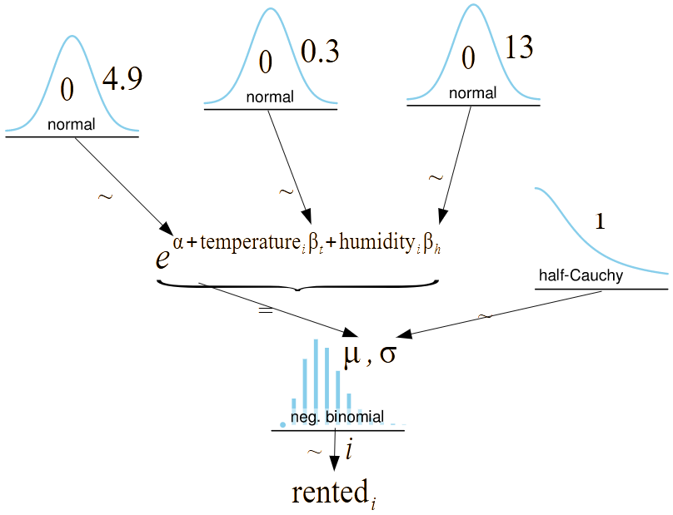
Multiple regression
model_th = bmb.Model("rented ~ temperature + humidity", bikes, family="negativebinomial")
idata_th = model_th.fit(random_seed=123)

Slide 19
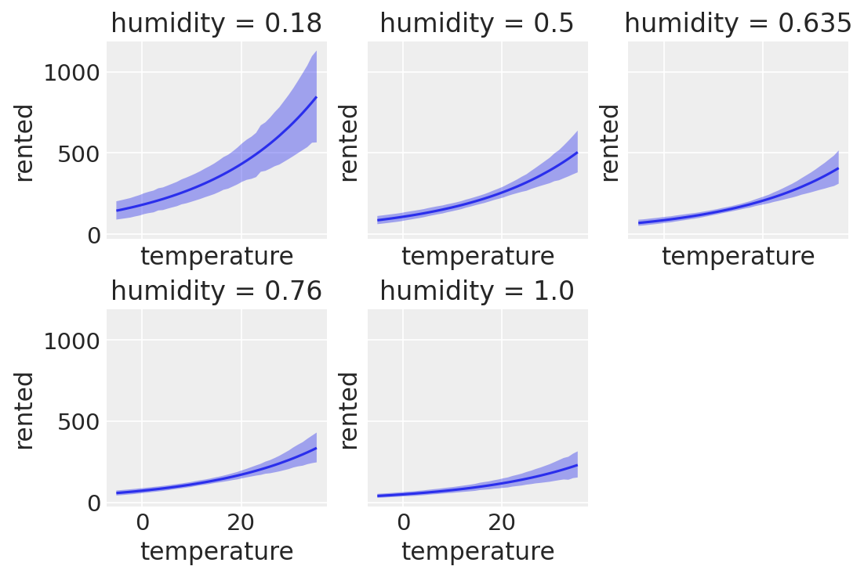
Predictive plots
bmb.interpret.plot_predictions(model_th, idata_th,
conditional={"temperature": bikes["temperature"],
"humidity": [0.18, 0.5, 0.635, 0.76, 1.0]},
subplot_kwargs={"group":None, "panel":"humidity"},
legend=False,
fig_kwargs={"sharey":True, "sharex":True});
Location | Summer humidity
Eilat | 19%
Be’er Sheva | 33%
Tel Aviv | 54%
Haifa University | 70%

Slide 20
Topics
Homework
Regression packages
Wilkinson notation
Regression packages
Bambi
Conditional prediction
Splines
Additional Bambi specifications
Distributional models
Hierarchical Bambi
Interactions in Bambi

Slide 21
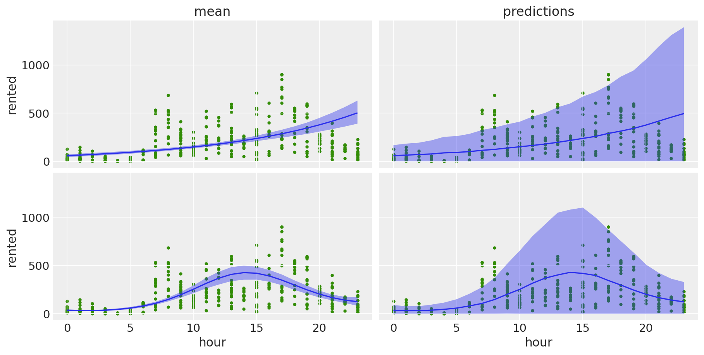
Polynomial fits
model_poly_1 = bmb.Model("rented ~ hour", bikes, family="negativebinomial")
model_poly_4 = bmb.Model("rented ~ poly(hour, degree=4)", bikes, family="negativebinomial")
bmb.interpret.plot_predictions(model_poly_1, idata_poly_1, "hour", ax=axes[0, 0])
bmb.interpret.plot_predictions(model_poly_1, idata_poly_1, "hour", pps=True, ax=axes[0, 1])
bmb.interpret.plot_predictions(model_poly_4, idata_poly_4, "hour", ax=axes[1, 0])
bmb.interpret.plot_predictions(model_poly_4, idata_poly_4, "hour", pps=True, ax=axes[1, 1])

Slide 22
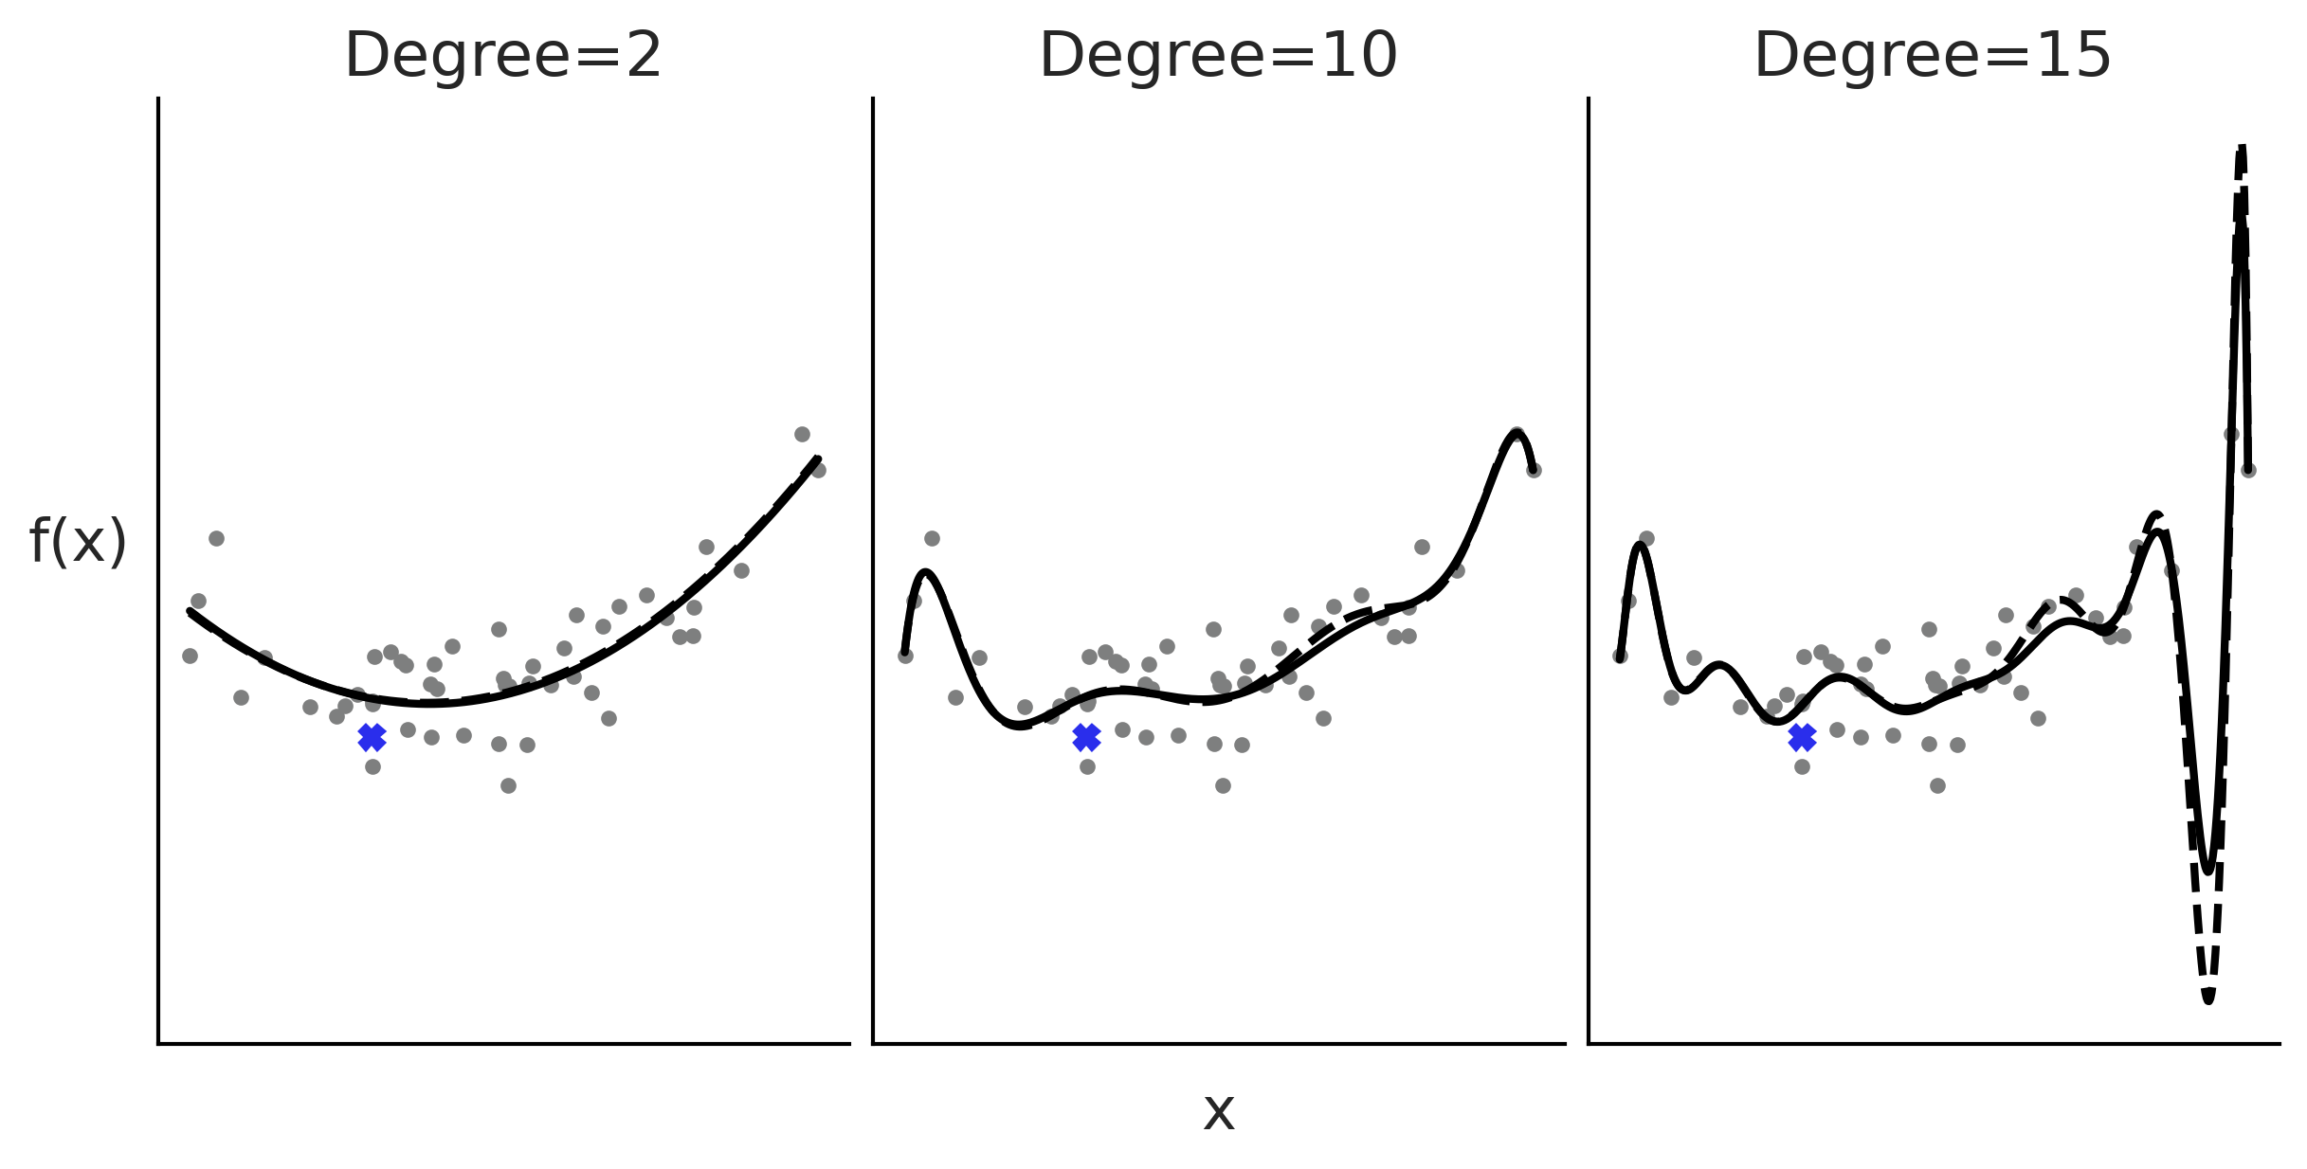
Limits of polynomial regression

Slide 23

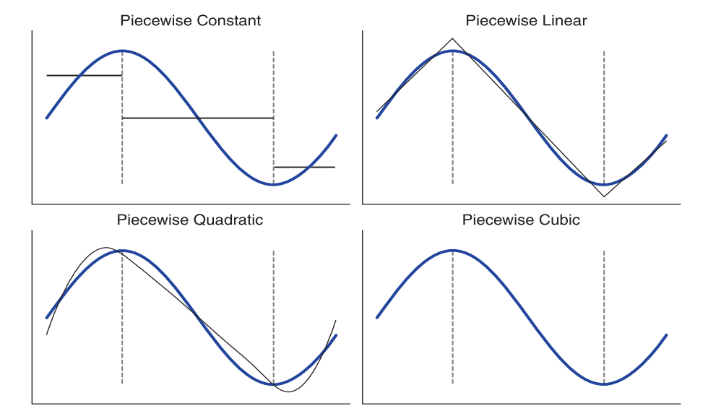
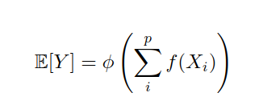
Alternative to polynomials
Non overlapping indicator functions
Generalized additive models (GAM)

Slide 24
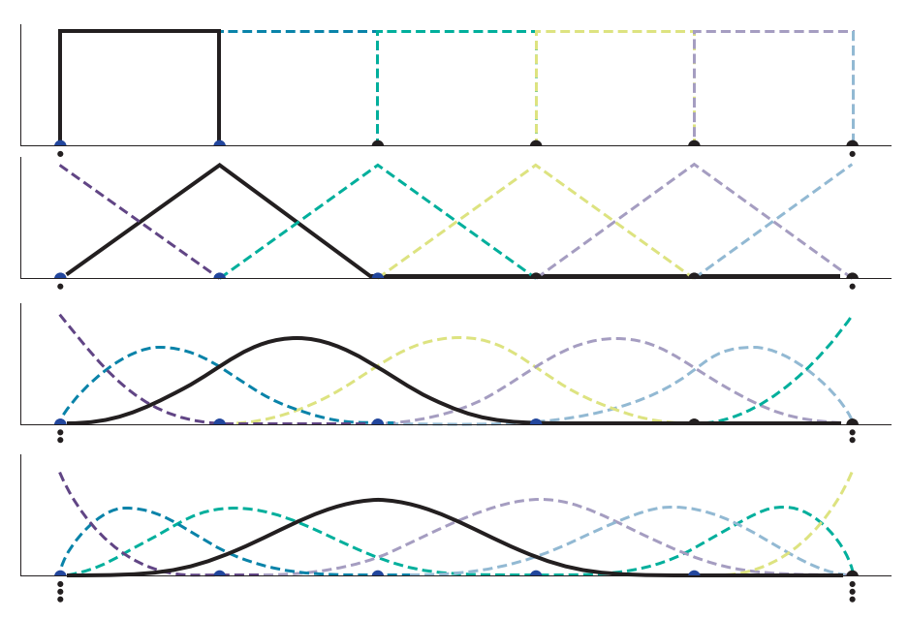
Generalize the idea of piecewise
Overlapping and contiguous
But still local
0 degree spline
In a spline of degree n:
The bases a polynomials of degree n
n+1 bases overlap between knots
n bases overlap at each knot
1 degree spline
2 degree spline
3 degree spline

Slide 25
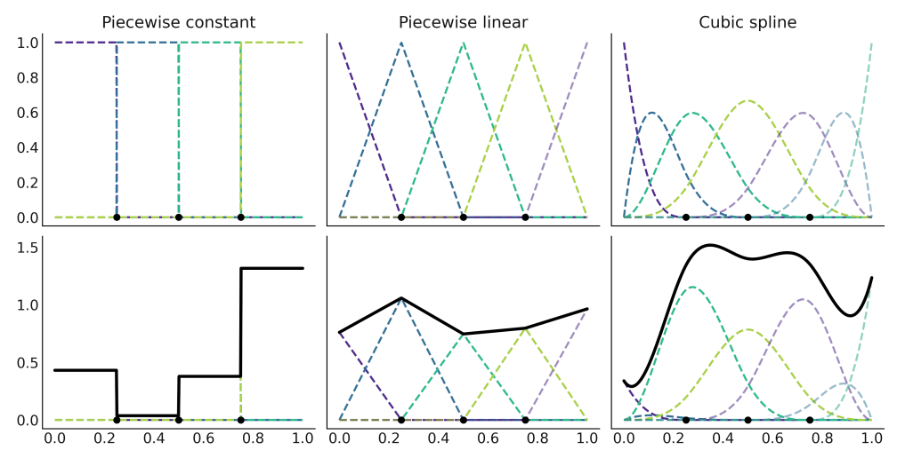
Fitting the basis elements to a function

Slide 26
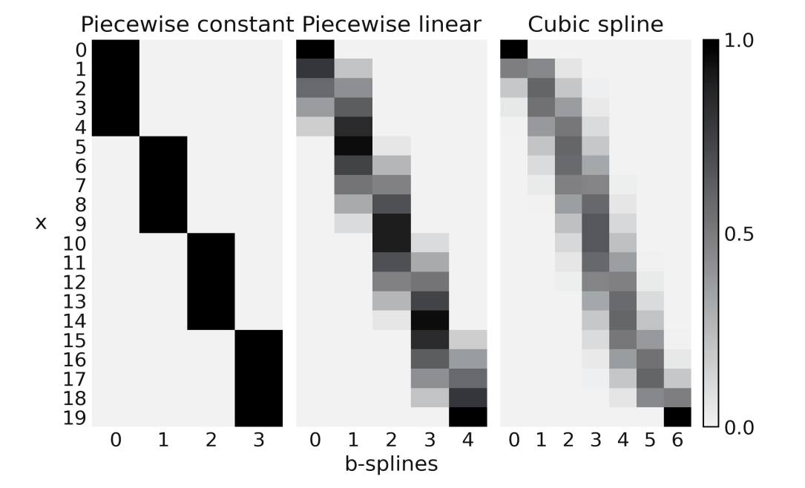
Turning splines into a regression

Slide 27
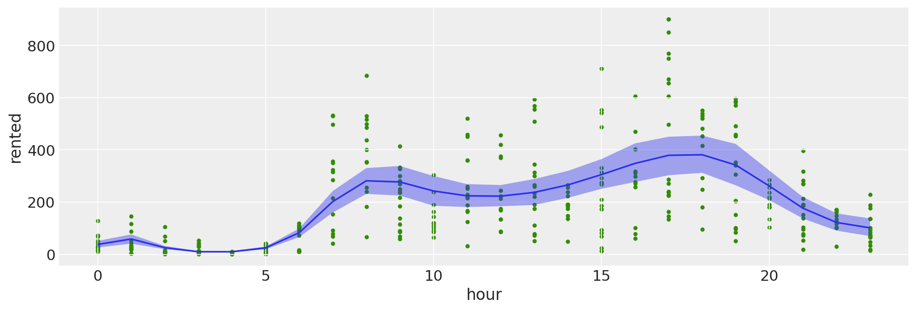
Fitting splines to bike data
num_knots = 6
knots = np.linspace(0, 23, num_knots+2)[1:-1]
model_spline = bmb.Model("rented ~ bs(hour, degree=3, knots=knots)", bikes, family="negativebinomial")
idata_spline = model_spline.fit(random_seed=123)
bmb.interpret.plot_predictions(model_spline, idata_spline, "hour", ax=ax)
ax.plot(bikes.hour, bikes.rented, "C2.", zorder=-3)

Slide 28
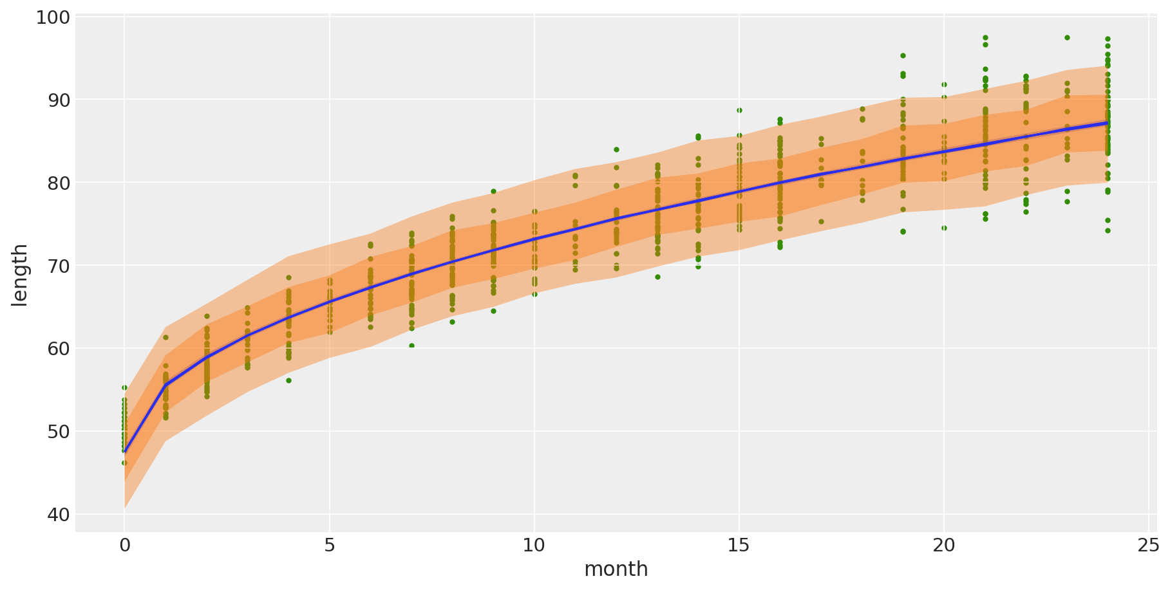
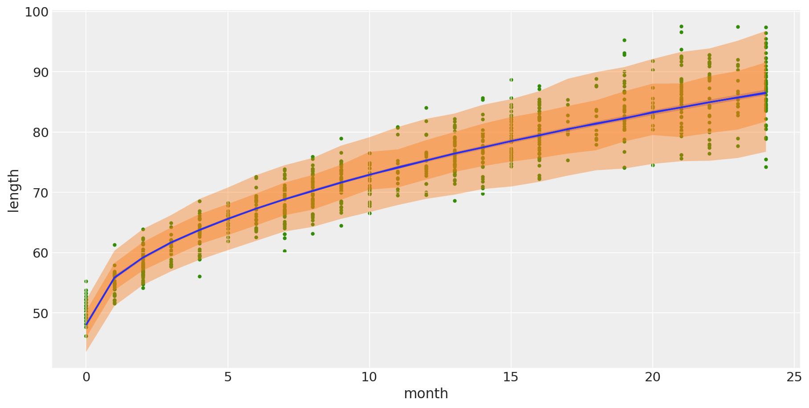
Distributional models
formula = bmb.Formula(
"length ~ np.sqrt(month)",
"sigma ~ month"
)
model_dis = bmb.Model(formula, babies)
model_cons = bmb.Model("length ~ np.sqrt(month)", babies)

Slide 29
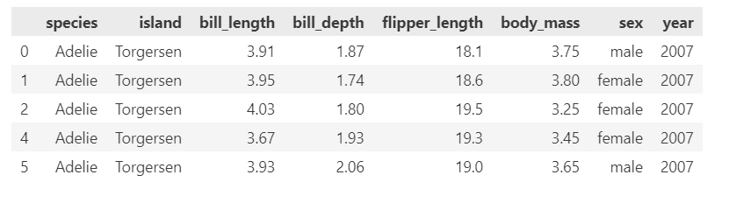
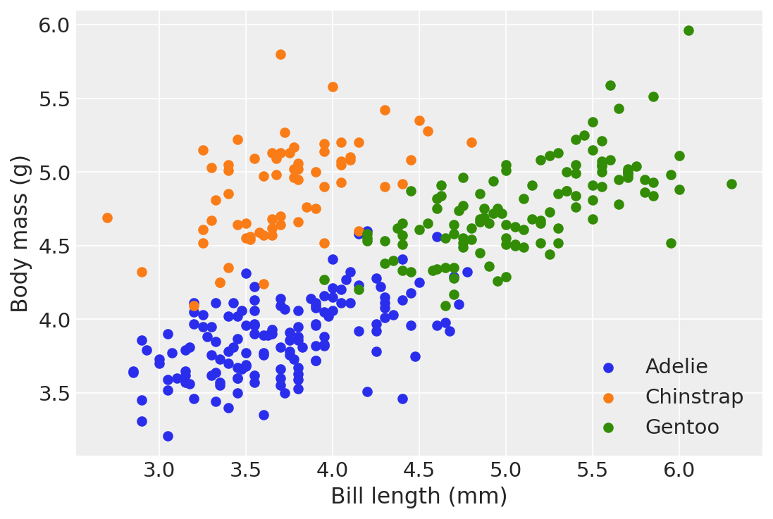
Categorical predictors (ANOVA)
The examples here need to be fixed:
Need example of categorical and continuous predictors
Example of using categorical predictors for classification with Bambi
Example of interaction with categorical and continuous predictors

Slide 30
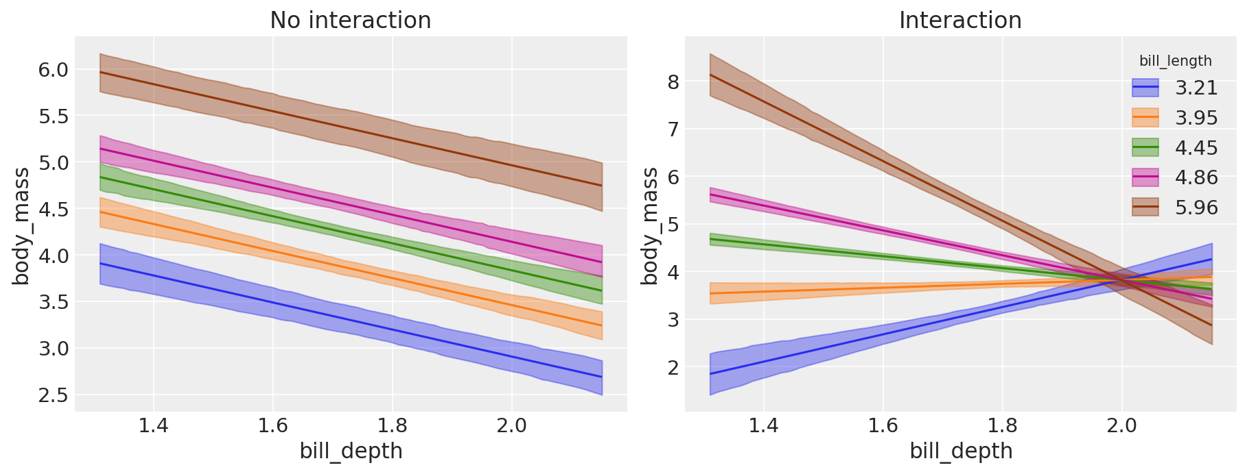
With and without interactions
model_int = bmb.Model("body_mass ~ bill_depth + bill_length + bill_depth:bill_length", data=penguins)
model_noint = bmb.Model("body_mass ~ bill_depth + bill_length", data=penguins)

Slide 31
Stuff to discuss
Homeworks?
Reading?
Exam date?
Projects?

Slide 32
Reading for next week
SR 12: Monsters and mixtures
Distributions as mixtures
Beta binomial
Negative binomial / gamma Poisson
Zero inflated models
Ordered categorical outcomes
Ordered categorical predictors
BAP Chapter 7: Mixture models
Gaussian mixture models
Identifiability
Choosing the number mixed
Zero counts
Zero inflated models
Hurdle models
Infinite mixture models
Distributions as mixtures

